Slide 1

Facial Diagnosis Using Deep Transfer Learning
by
Vasantha Lakshmi P
Roll No. 174G1A05A8
Saif Sadiq S
Roll No. 184G1A082
Tasneem S
Roll No. 184G1A05A4
Udayasree K
Roll No. 184G1A05A6
Under the guidance of
Mr. C. Sudheer Kumar M.Tech., (Ph.D)
Assistant Professor
Department of Computer Science and Engineering
Srinivasa Ramanujan Institute of Technology
(Affiliated to JNTUA & Approved by AICTE) (Accredited by NAAC with ‘A’ Grade & Accredited by NBA (EEE, ECE & CSE)
Rotarypuram Village, B K Samudram Mandal, Ananthapuramu – 515701.
2021 - 2022

Slide 2
Abstract
The relationship between face and disease has been discussed for thousands of years, which leads to the occurrence of facial diagnosis. The objective here is to explore the possibility of identifying diseases from uncontrolled 2D face images by deep learning techniques. we are going to use deep transfer learning ,CNN from face recognition to perform the computer-aided facial diagnosis on various diseases. In the experiments, we perform the computer-aided facial diagnosis on diseases like beta-thalassemia, hyperthyroidism, Down syndrome, and leprosy with a relatively a dataset.
The overall accuracy by deep transfer learning from face recognition is which outperforms the performance of both traditional machine learning methods and clinicians in the experiments. The success of deep transfer learning applications in facial diagnosis with a small dataset could provide a low-cost and noninvasive way for disease screening and detection.

Slide 3
Contents
Introduction
Literature Survey
Existing System
Proposed System
Problem Definition
Requirements
Architecture
UML Activity diagram
UML dataflow
UML E-R
UML use case
Implementation
Execution & results
References

Slide 4
Introduction
Facial diagnosis is one of the most important applications in facial analysis. It can be traced back thousands of years when traditional medicine practitioners applied their knowledge to diagnose the health status of an individual.
It indicates the pathological changes of the internal organs can be reflected in the face of the relevant areas.
It is still difficult for people to take a medical examination in many rural and underdeveloped areas because of the limited medical resources, which leads to delays in treatment in many cases.
Now, Computer-aided facial diagnosis refers to that practitioners perform disease diagnosis by observing facial features.
Computer-aided facial diagnosis enables us to carry out non-invasive screening and detection of diseases quickly and easily.

Slide 5
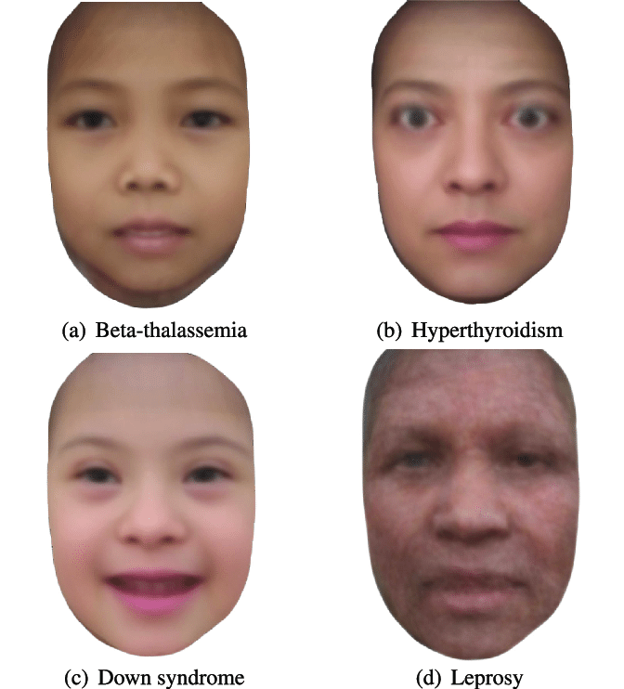
Reference Images

Slide 6
Contd….
Therefore, if facial diagnosis can be proved effective with an acceptable error rate, it will be with great potential. With the help of artificial intelligence, we could explore the relationship between face and disease with a quantitative approach.

Slide 7
Literature Survey
As our project has to prefer journals and published papers and also we have used some websites to understand the problem.
[1][Bo Jin, Leandro Cruz, and Nuno Goncalves]IEEE, Facial Diagnosis refers to the practitioners perform disease diagnosis by observing facial features. Deep learning technology shows significant performance. Face recognition refers to the technology of verifying or identifying the identify of subjects from images. Transfer learning is to apply the knowledge gained while solving one problem. In this paper, they used ResNet50 CNN architecture model.
[2]“Image Classification Using Transfer Learning and Deep Learning” To train a model on a huge dataset demands huge computational resources and adds a lot of cost to learning. Transfer learning allows to reduce the cost of learning and also help avoid reinventing the wheel. This paper demonstrates image classification using pretrained deep neural network model vgg16 which is trained on images from ImageNet dataset.

Slide 8
Contd..
[3][Haihong Pan, Zaijun Pang, Yaowei Wang, Yijue wang , And Lin Chen ] The weights of the pre-trained model on the ImageNet dataset are re-saved to the MobileNet feature extractor to classify welding defects (Fig. 2). Then the depth-separate convolution applies several filters to the local area of the input image to obtain the feature map. In this paper, the image recognition using transfer learning and mobile net combined is discussed, which will help our project to know the architecture of mobilenet and how transfer learning is done.
Model used: MobileNet

Slide 9
Existing System
Earlier old methods like screening by a physician in laboratories with equipments .This system also required for us to know what we are looking for from the start.
The Machine learning Algorithms are used like Bayesian Belief Networks and Face Expression Analysis.
These algorithms take more time to generate results, low accuracy and cost ineffective.

Slide 10
Proposed System
In Proposed System, we are Using Deep Transfer Learning, Neural networks and Face recognition to capture the faces of people and detect any possible disease associated to them.
Deep Transfer Learning offers increased accuracy in detection of disease and it is highly scalable.
Face recognition refers to the technology of verifying or identifying the identity of subjects from faces in images or videos.
We are going to use convolutional Neural networks(CNN) such as MobileNet. It is the most commonly used deep learning method in Face recognition.

Slide 11
Problem Definition
It is still difficult for people to take a medical examination in many rural and underdeveloped areas because of the limited medical resources, which leads to delays in treatment in many cases. Even in metropolises, limitations including the high cost, long queuing time in hospital and the doctor-patient contradiction which leads to medical disputes still exist. Computer-aided facial diagnosis enables us to carry out Non-invasive screening and detection of diseases quickly and easily with less error rate.
The Early prediction and treatment of Face based Diseases is to be done.

Slide 12
Requirements
SYSTEM SPECIFICATIONS:
H/W Specifications:
Processor :I3/Intel Processor
RAM : 8GB(min)
Hard Disk : 128 GB
S/W Specifications:
Operating System :Windows 7+
Server side script : python 3.6
IDE : PyCharm
Libraries Used : Numpy, Tenserflow, pandas,keras

Slide 13
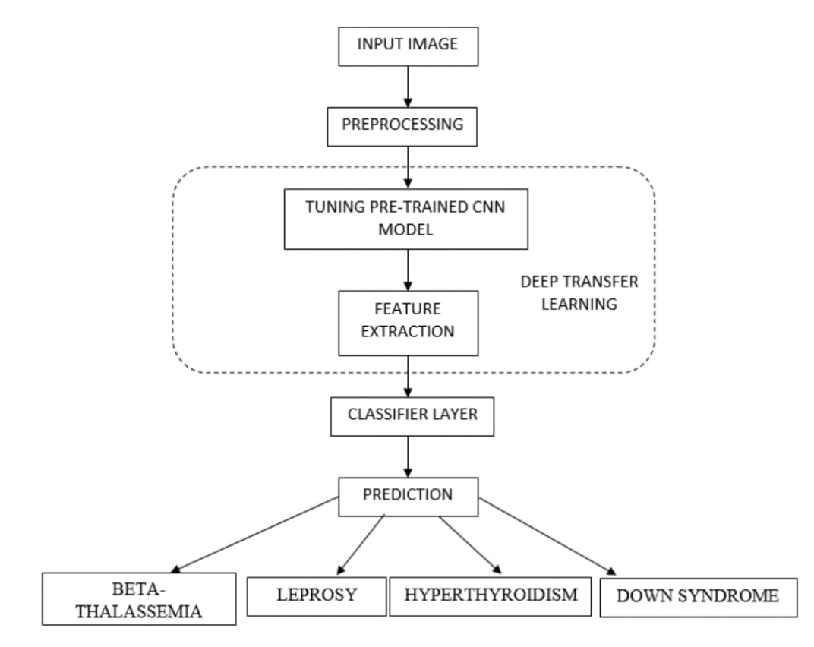
Architecture

Slide 14
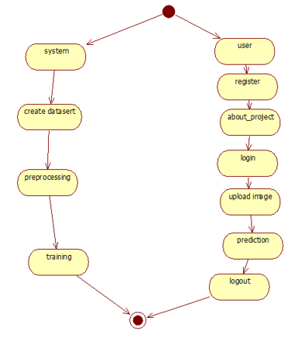
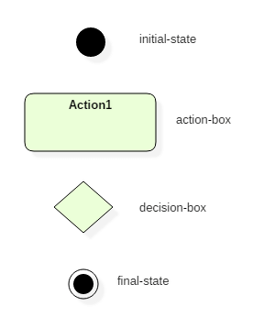
UML Activity Diagram
System
user
register
Creating a model
About project
login
Preprocessing, feature extraction
Upload image
prediction
Training and testing model, classify
logout

Slide 15
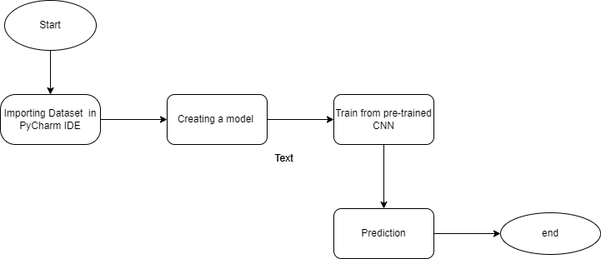
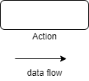
UML Data flow diagram
Import Dataset

Slide 16
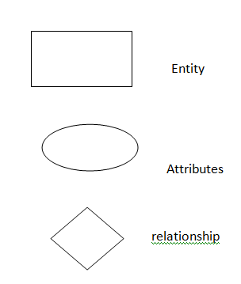
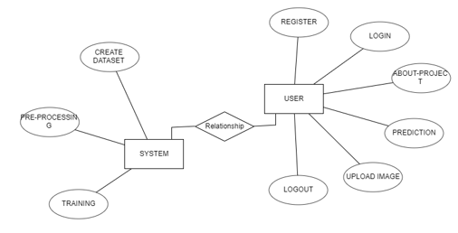
E-R diagram

Slide 17
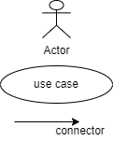
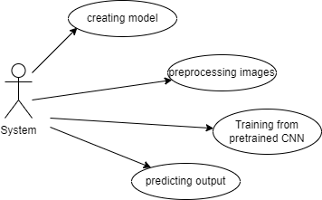
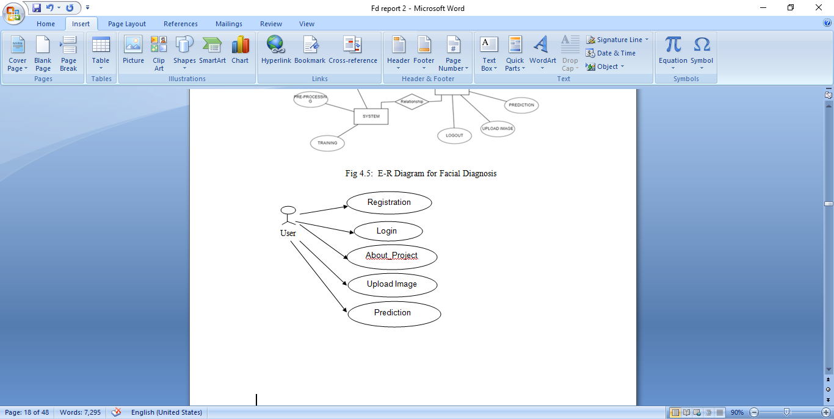
UML use case diagrams

Slide 18
Implementation
1.Dataset:
By using Keras on the top of Tenserflow to accomplish transfer learning, and access images in PyCharm.
from tensorflow.keras.preprocessing import image
2.Create a model:
We are going to create a model, MobileNet which takes dataset to predict output.
from tenserflow.keras.images import Model,MobileNet
base_model=MobileNet(weights='imagenet')
3.Feeding data to model
we will use the ImageDataGenerator which will also help us augment our data
data_gen=ImageDataGenerator(input) –function
4.Train and test the images from directory
5.Compile and Save the model
model.save(‘/location/path’)

Slide 19
Sample code
Sample code:
from tensorflow.keras.preprocessing import image
from tensorflow.keras.models import Model
import numpy as np
base_model=MobileNet(weights='imagenet',include_top=False)
GlobalAveragePooling2D( )
x=Dense(1024,activation=’Relu’)
train_datagen=ImageDataGenerator(input)
train_generator=train_datagen.flow_from_directory('Dataset/train',parameters)
test_generator=test_datagen.flow_from_directory('Dataset/train',parameters)
model.compile()
model.save(‘/location/path’)

Slide 20
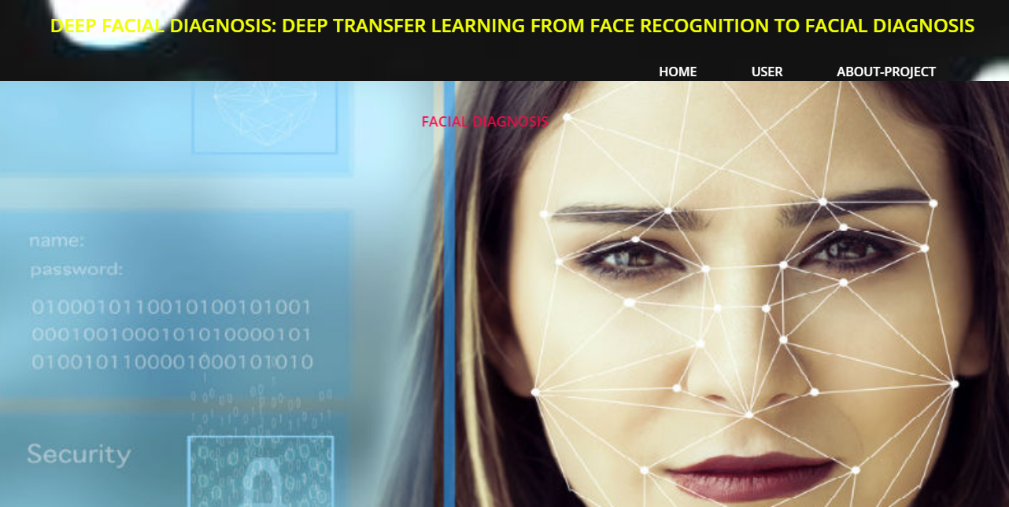
Results
1.Home Page

Slide 21
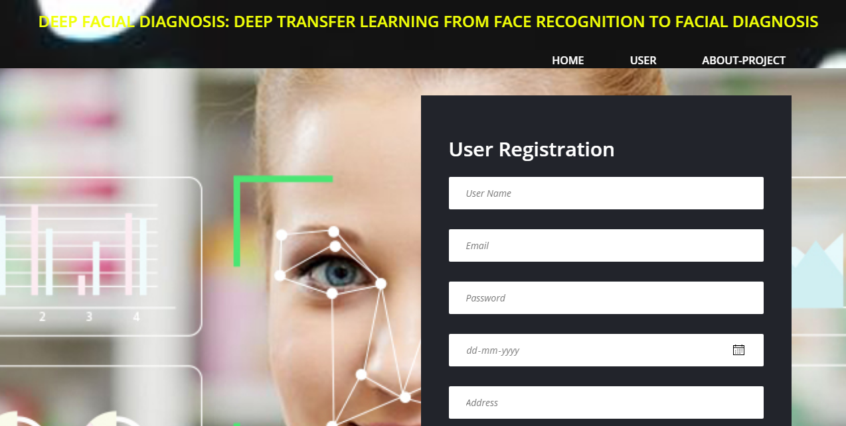
Results
2.User Registration

Slide 22
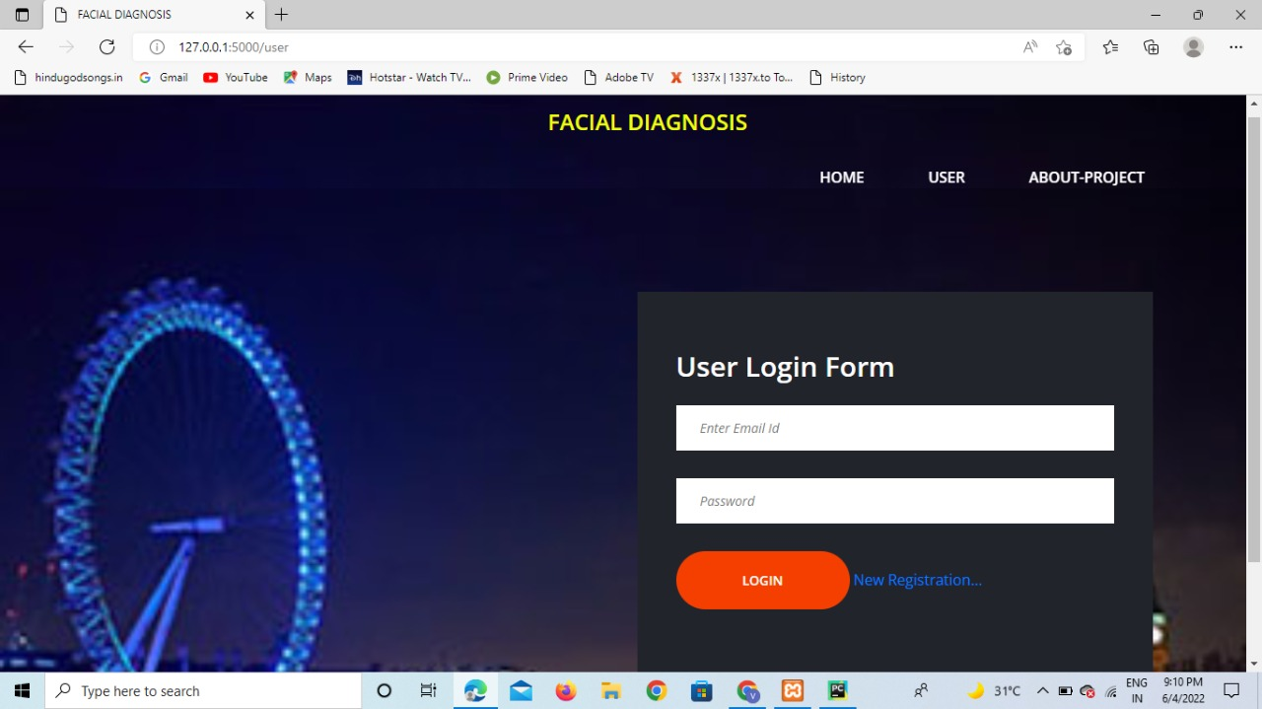
Results
3.Login

Slide 23
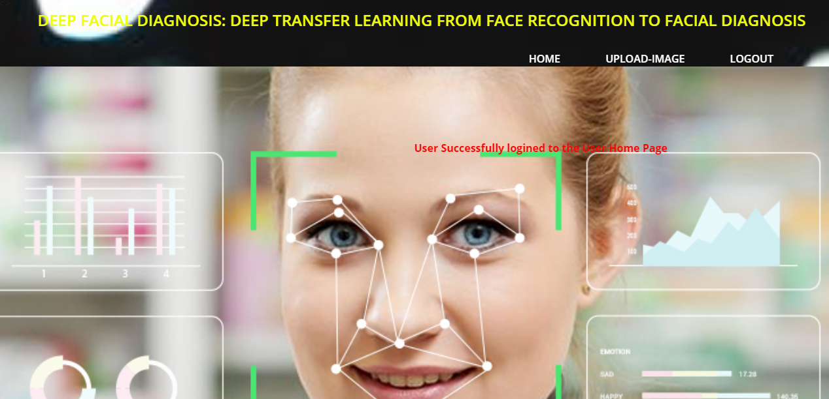
Results
4. User Home Page

Slide 24
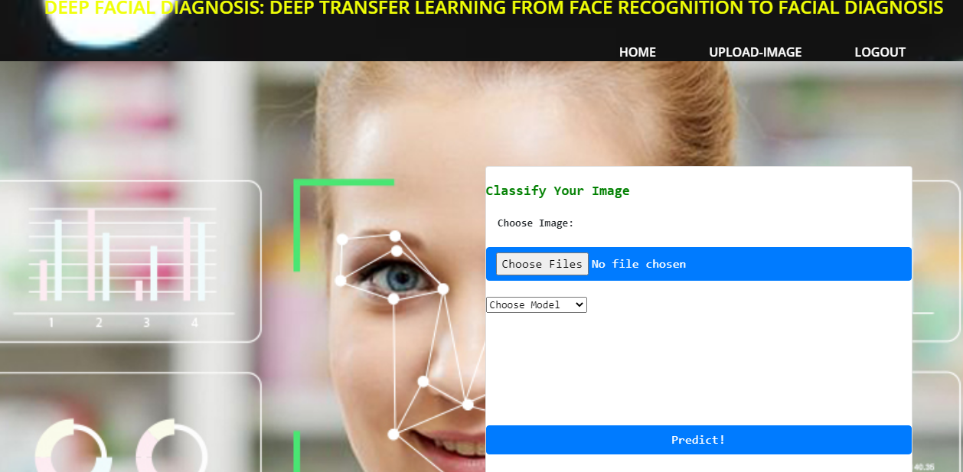
Results
5. Upload image

Slide 25
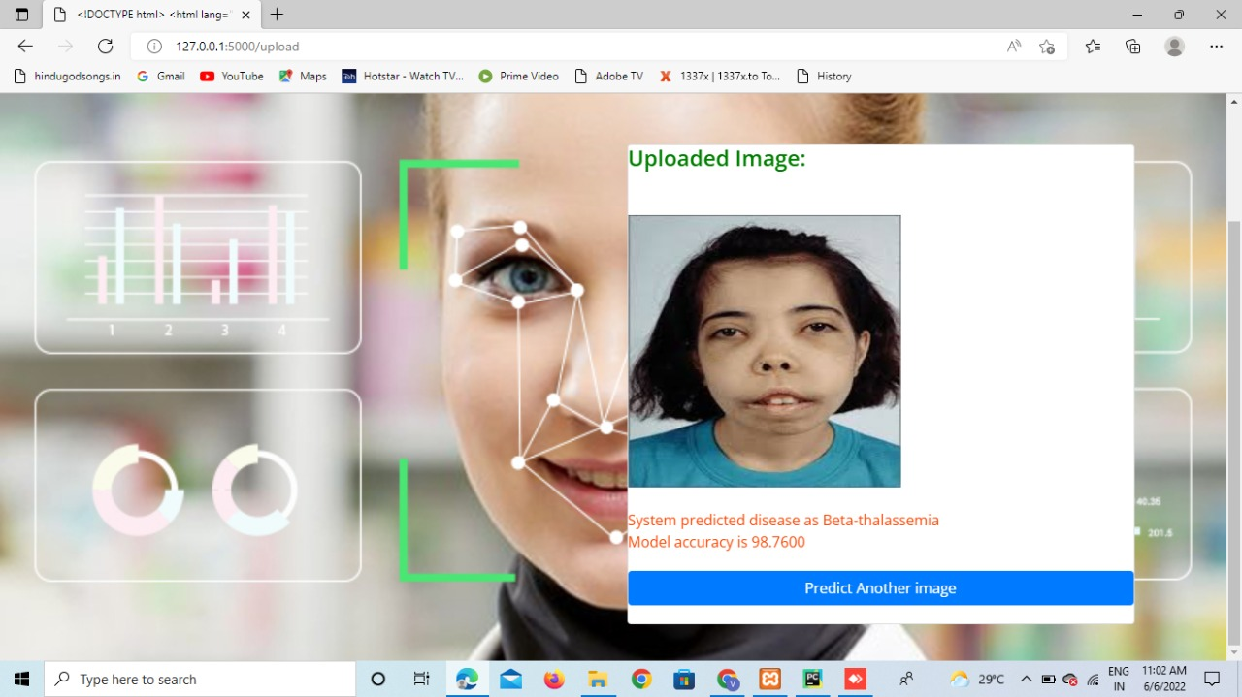
Results
Beta-Thalasemia Prediction

Slide 26
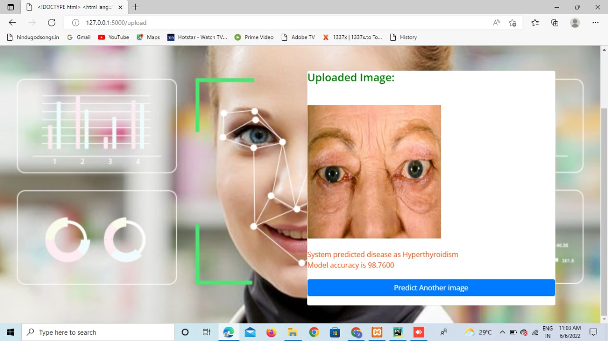
Results
Hyper-Thyroidism prediction

Slide 27
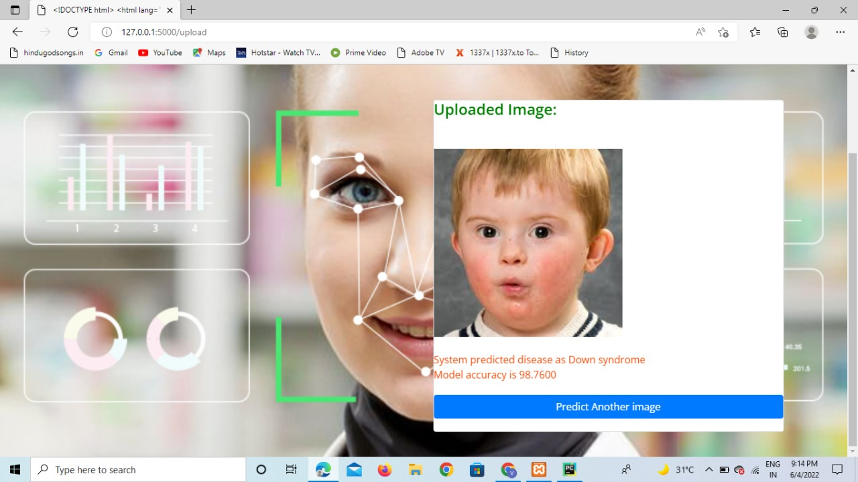
Results
Down Syndrome prediction

Slide 28
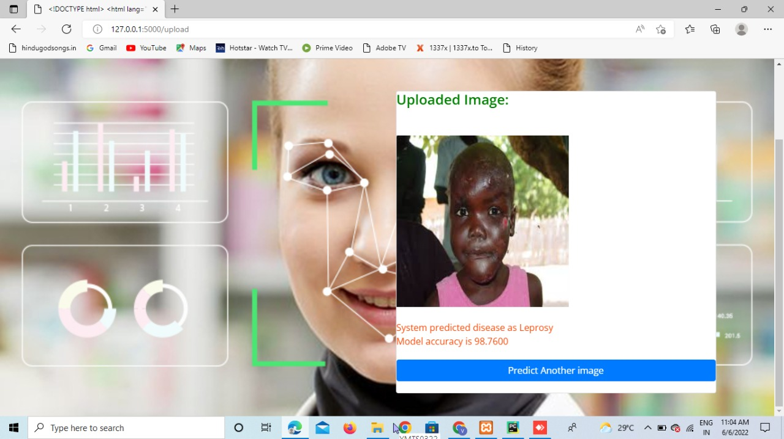
Results
Leprosy prediction

Slide 29
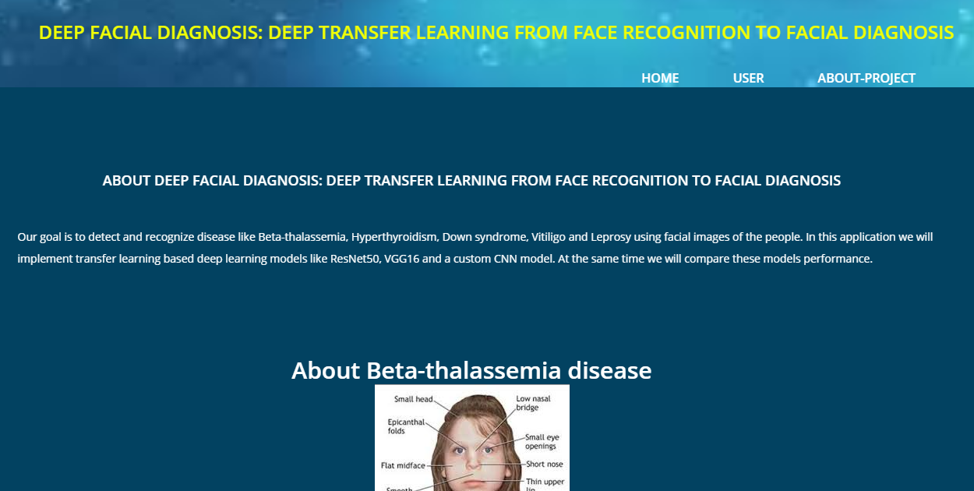
Results
6.About Home page

Slide 30
Conclusion
More and more studies have shown that computer-aided facial diagnosis is a promising way for disease screening and detection. We used deep transfer learning from face recognition methods to realize computer-aided facial diagnosis defifinitely and validate them on single disease and various diseases with the healthy control. The experimental results of above 90% accuracy have proven that CNN as a feature extractor is the mostappropriate deep transfer learning method in the case of the small dataset of facial diagnosis. It can solve the general problem of insuffificient data in the facial diagnosisarea to a certain extent. In future, we will continue to discover deep learning models to perform facial diagnosis effectively with the help of data augmentation methods. We hope that more and more diseases can be detected effificiently by face photographs.

Slide 31
References
[1]. Bo Jin, Leandro Cruz, and Nuno Goncalves, “Deep Facial Diagnosis ”, IEEE Access, 29 June 2020.
[2]. Haihong Pan, Zaijun Pang, Yaowei Wang, Yijue wang , And Lin Chen , “Image recognition combining Transfer learning and MobileNet model”, IEEE Access, July 9, 2020.
[3]. Barlian Khasoggi, Ermatita, Samsuryadi, “Efficient mobilenet architecture as image recognition”, Master of Informatics Engineering,Sriwijaya University, Indonesia, Vol. 16, No. 1, October 2019.
[4].“Image Classification Using Transfer Learning and Deep Learning” International Journal Of Engineering And Computer Science Volume :10 Issue: 9 September 2021.
[5]. Kaun Wang, jeibo luo , “Detecting visually observable disease from faces”, vol:9, Mar 2016.

Slide 32
Thank You!!!

